Slide 1
Fetal Monitoring
Definition, Interpretation and Management
Debra Sperling, MA, BSN, RNC-OB, C-EFM, NE-BC

Slide 2
Intrapartum FHR monitoring is the single most common obstetric procedure in the US, impacting the lives of almost 8 million mothers and babies each year…
Notes:
When you think about it, some version of fetal monitoring is performed in almost every setting that someone chooses to deliver

Slide 3
Electronic FHR monitoring is NOT a diagnostic test It is a screening test Except in the most extreme cases, it has never been capable of reliably diagnosing fetal injury or impending injury
Notes:
Even though FM has been extensively studied, and standardized terminology has been implemented to make analysis objective, it is still extremely unreliable in predicting or diagnosing injury.
Continuous EFM is not effective in improving outcomes in healthy women with uncomplicated pregnancies. EFM has become STANDARD PRACTICE.
EFM reduces neonatal morbidity and mortality, but increases cesarean rates and operative vaginal delivery including maternal morbidity.
No clear answer: institutional standards and policies must be followed: perhaps more IA in appropriate patient, fear of litigation.

Slide 4
Let’s start with the basics
Undertake the simple exercise of deconstructing fetal heart rate monitoring into its essential components

Slide 5
FHR monitoring consists of 3 components
Intrapartum
FHR
Monitoring
Definition
Interpretation
Management

Slide 6
Or in common terms…
Definition – What do I call it?
Interpretation – What does it mean?
Management – What do I do about it?
Notes:
1997 NICHD sponsored worship to develop standardized common language; purpose to reduced miscommunication between providers: Must be OBJECTIVE: different reviewers come to same conclusion
2008 ACOG & AWHONN reviewed definitions and need for standardized system for interpretation of intrapartum tracings: added terminology for excessive uterine activity and adoption of the 3 tiered system

Slide 7
Definition
Along with uterine contractions, there are 5 essential components of a FHR tracing:
Baseline rate
Variability
Accelerations
Decelerations
Changes or trends over time
Notes:
Changes or trends over time: gets ignored?
Baseline changes from 120-160 may indicate infection
Changes in variability from mostly moderate to minimum

Slide 8
FHR Baseline
Approximate mean FHR rounded to increments of 5 BPM during a 10 min segment excluding accelerations and decelerations and periods of marked variability.
In any 10-minute window the minimum baseline duration must be at least 2 minutes (not necessarily contiguous or the BL for that period is indeterminate). In that case one may need to refer to the previous 10-minute segment.
The baseline is visually apparent
Normal: 110 to 160 beats per minute
Bradycardia: Less than 110 beats per minute
Tachycardia: Over 160 beats per minute

Slide 9
FHR Baseline
Notes:
Draw an imaginary line through the mean

Slide 10
FHR Baseline

Slide 11
Fetal Tachycardia: Baseline > 160 bpm Baseline 180 BPM

Slide 12
The most common causes of fetal tachycardia include:
Response to fetal activity
Maternal fever
Fetal infection
Use of beta-sympathomimetric medications, such as terbutaline
Fetal Anemia
Fetal distress
Maternal hyperthyroidism
Notes:
SYM-Patho-mimetric

Slide 13
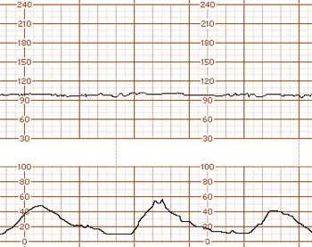
Fetal Bradycardia: Baseline < 110 bpm
Notes:
Sometimes this can be normal: example a fetus with a heart block

Slide 14
The most common causes of fetal bradycardia include:
Fetal distress
Maternal autoimmune diseases
such as lupus
3. Fetal arrhythmias
Notes:
Some bradycardias will come up in the antepartum period and can be cleared by cardiology, such as a heart block. More concerning is a normal tracing that becomes a bradycardia, such as a cord prolapse or sudden severe hypotensive event after an epidural

Slide 15
Variability is defined by the 1997 and 2008 NICHD Consensus statements as:
Fluctuations in the
baseline that are irregular in amplitude and frequency

Slide 16
FHR Variability is…
Integrated activity between the sympathetic and parasympathetic branches of the central nervous system.
In other words:
Variability evaluates the fetal neurologic state.
Moderate variability means the fetus has a
healthy nervous system at that moment in time.
Notes:
Variability is described as the push-pull of the two branches of the CNS

Slide 17
Variability Definitions
Classification | Amplitude Range
Absent | undetectable
Minimal | Visually detectable from baseline and less than or equal to 5 beats
Moderate | 6-25 beats
Marked | Greater than 25 beats
Notes:
Fluctuations in the baseline that are:

Slide 18
Amplitude
Notes:
TROFF

Slide 19
Absent Variability
Notes:
Absent variability does not have to be a straight line drawn by a ruler. There are no peaks and troffs, merely wandering hills and valleys with a smooth appearance

Slide 20
Absent Variability

Slide 21
Minimal Variability
Notes:
You can see that there are visually apparent fluctuations in the baseline: a good way to determine is to look at the parallel lines that are in increments of 10 beats per minute. Minimal variability is fluctuations are only ½ of the box or less. You are always looking at what characteristics are the majority of those presenting during the time frame you are evaluating. On the right side, there is moderate variability, but the majority of this tracing is minimal

Slide 22
Moderate Variability

Slide 23
Marked Variability
Notes:
Relatively uncommon, occurring in approximately 2% of FHR tracings. It has a chaotic appearance

Slide 24
Marked Variability
Notes:
Note how chaotic this pattern appears

Slide 25
Marked Variability
What is marked variability?
Marked variability may represent an increased sympathetic response in the neonate due to a stressful intrapartum event (such as cord compression) that has not occurred with enough frequency or intensity to cause overt acidemia.
May occur after Ephedrine administration
Multiple studies done:
Conclusion: In the absence of abnormal FHR changes, it is Not associated with increased risk of neonatal morbidity
Marked variability is significantly associated with increased risk of respiratory distress and elevated cord blood lactate.
Notes:
It is associated with a 2-fold increased risk of neonatal acidosis. Correct pattern with interventions with goal of returning to moderate variability

Slide 26
Sinusoidal: A visually apparent, smooth, sine wave-like undulating pattern with a cycle frequency of 3-5/min that persists for ≥ 20 minutes.

Slide 27
Sinusoidal: A visually apparent, smooth, sine wave-like undulating pattern with a cycle frequency of 3-5/min that persists for ≥ 20 minutes.
Notes:
Sinusoidal with very high rate

Slide 28
Sinusoidal pattern
Thought to signify a compromised fetus: In most cases secondary to fetal anemia.
Fetal anemia can occur from many different causes
RH isoimmunization
Fetomaternal transfusion
Bleeding vasa previa
Other causes of fetal bleeds (for example a traumatic amniocentesis)
Notes:
This is the most common cause of sinusoidal patterns. With RH, patient may appear to L&D with this pattern

Slide 29
Sinusoidal pattern
Other causes include:
Fetal asphyxia/hypoxia
Fetal infections
Fetal cardiac anomalies
Sinusoidal pattern is category 3 and requires immediate evaluation. This pattern is associated with increased risk of fetal acidemia

Slide 30
Pseudo sinusoidal pattern
Can be caused by certain drugs, particularly narcotics
Sucking or rhythmic movements of the fetal mouth
Fetal sleep cycle
These undulating tracings are of short duration, and preceded and followed by FHR with normal characteristics
Are considered benign
Are often confused with true sinusoidal.

Slide 31
Pseudo sinusoidal pattern

Slide 32
Pseudo sinusoidal pattern

Slide 33
Pseudo sinusoidal pattern

Slide 34
Hints for Interpretating Variability
Three S’s
Sleep
Sick
Sedation
Notes:
Sleep cycle usually lasts 20-40 minutes. Fetuses between 30-40 weeks have wide variations in % of time spent in sleep-wake states, sometimes one hour
Sick: insult before appearing in L&D, reduced oxygen through placenta,

Slide 35
Accelerations
Based on visual assessment, an acceleration is defined as:
An apparent abrupt increase in fetal heart rate of at
least 15 beats above the baseline. Onset to peak is
equal to or less than 30 seconds and duration is equal
to or more than 15 seconds and less than two minutes
from onset to return to baseline
Notes:
More commonly known as 15X15

Slide 36
Accelerations
In pregnancies < 32 weeks gestation, accelerations are defined as an increase of 10 beats per minute or more above baseline which lasts 10 seconds or more. (10X10)
An acceleration is classified as prolonged if the duration is 2 minutes or more but less than 10 minutes.
Accelerations that are 10 minutes or more are considered a baseline change
Notes:
Once a preterm fetus demonstrates 15X15 accelerations, it is abnormal if they revert to 10X10

Slide 39
Late Decelerations
Visually apparent usually symmetrical gradual decrease and return of the fetal heart rate (FHR) associated with a uterine contraction.
A gradual FHR decrease is defined as from the onset to the FHR nadir of 30 seconds or more.
The deceleration is delayed in timing, with the nadir of the deceleration occurring after the peak of the contraction.
In most cases, the onset, nadir, and recovery of the deceleration occur after the beginning, peak, and ending of the contraction, respectively

Slide 40
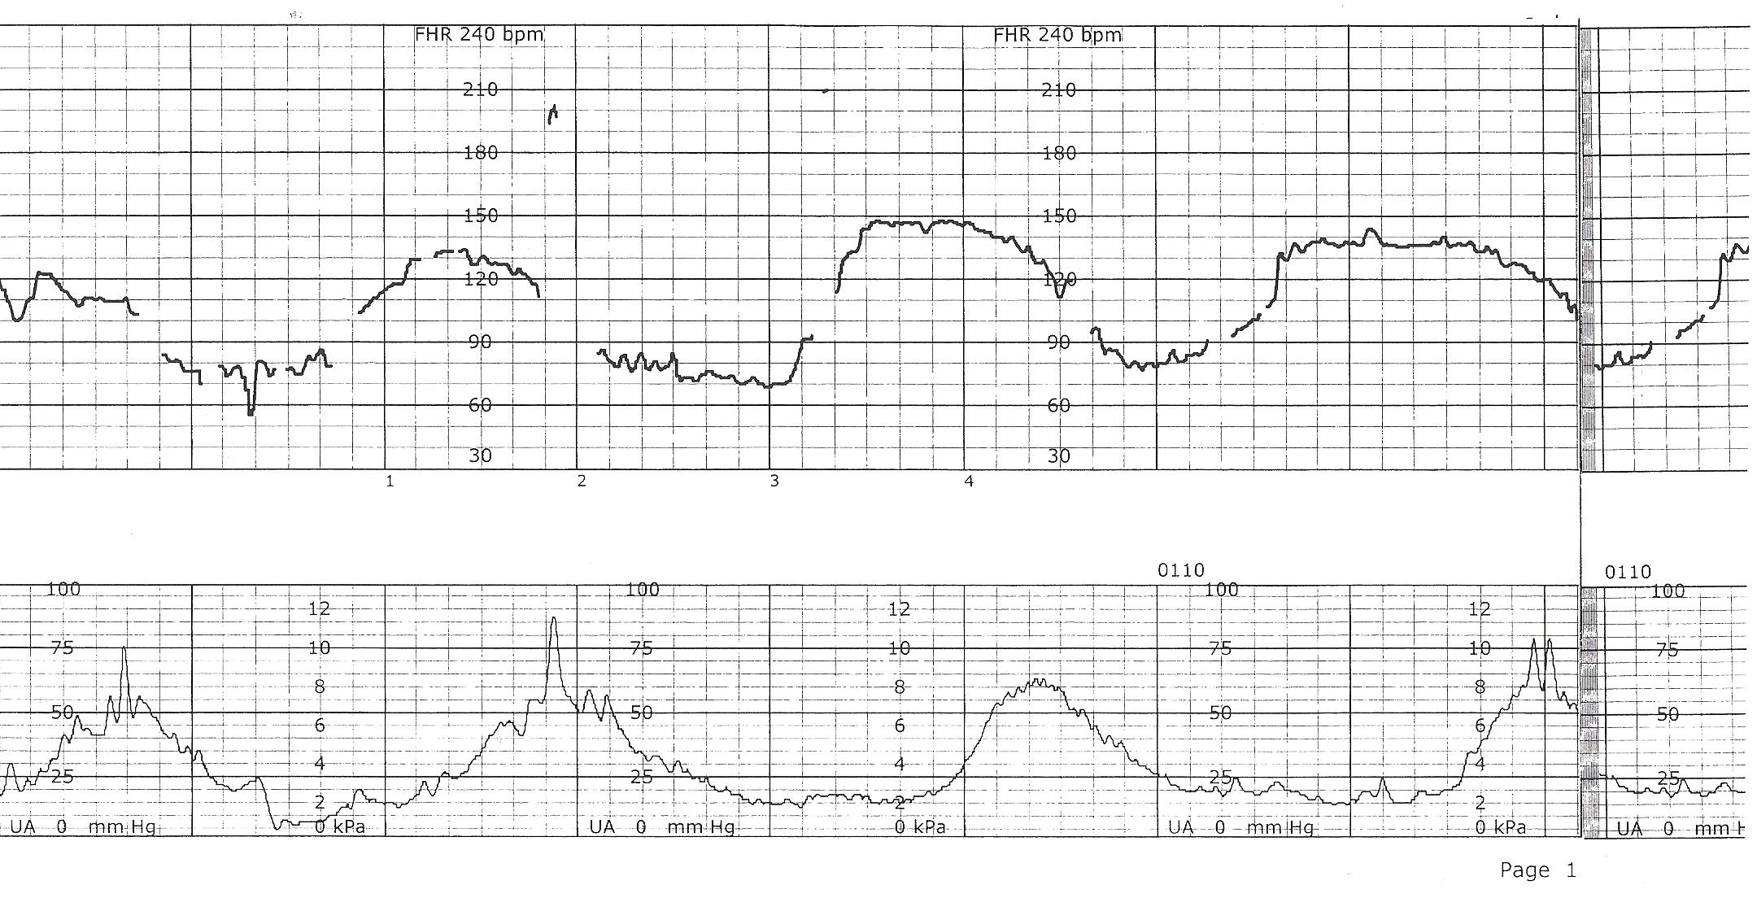
Late Decelerations
Notes:
Late decelerations do not have to be this obvious. They can be very subtle and still be concerning for utero-placental insufficiency

Slide 41
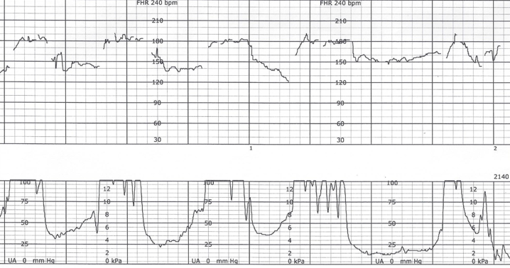
Are these Late Decelerations?
Notes:
You can see that this patient is pushing. This tracing needs to be adjusted so there are no blank areas, and have a pulse oximeter placed to ensure you are recording FHR. Many unexpected neonatal poor outcomes have resulted in the nurse inadvertently monitoring the maternal pulse instead of the FHR. A pulse oximeter is recommended for 2nd stage in particular.

Slide 42
Early Decelerations
Visually apparent, usually symmetrical, gradual decrease and return of the FHR associated with a uterine contraction.
A gradual FHR decrease is defined as onset to the FHR nadir of 30 seconds or more.
The decrease in FHR is calculated from the onset to the nadir of the deceleration.

Slide 43
Early Decelerations
The nadir of the deceleration occurs at the same time as the peak of the contraction.
In most cases the onset, nadir, and recovery of the deceleration are coincident with the beginning, peak, and ending of the contraction.
As early decelerations are NOT associated with decreased fetal oxygenation or metabolic acidosis, they do not require treatment

Slide 44
Early Decelerations
Thought to be caused by vagal response of pressure on the fetal head caused by a contraction
Present in category 1 tracings

Slide 45
Early Decelerations
Notes:
This tracing does not meet exact criteria per definition, but overall appearance is of early decelerations.
Not every tracing will exactly fit the NICHD definitions:

Slide 46
Variable Decelerations
Visually apparent abrupt decrease in FHR.
An abrupt FHR decrease is defined as from the onset of the deceleration to the beginning of the FHR nadir of less than 30 seconds.
The decrease in FHR is greater than or equal to 15 beats per minute, lasting greater than or equal to 15 seconds, and less than 2 minutes in duration.
When variable decelerations are associated with uterine contractions, their onset, depth, and duration commonly vary with successive uterine contractions.
Notes:
Variables are very common: seen in just about every labor at some point, particularly in 2nd stage

Slide 47
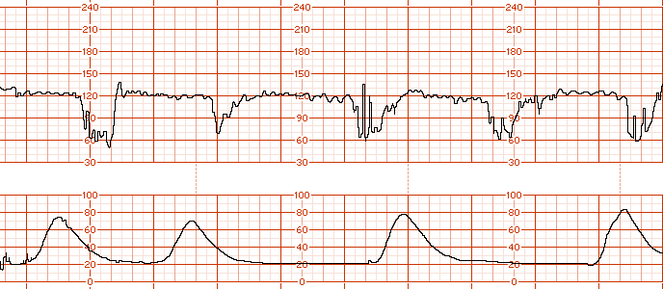
Variable Deceleration

Slide 48
Variable Deceleration

Slide 49
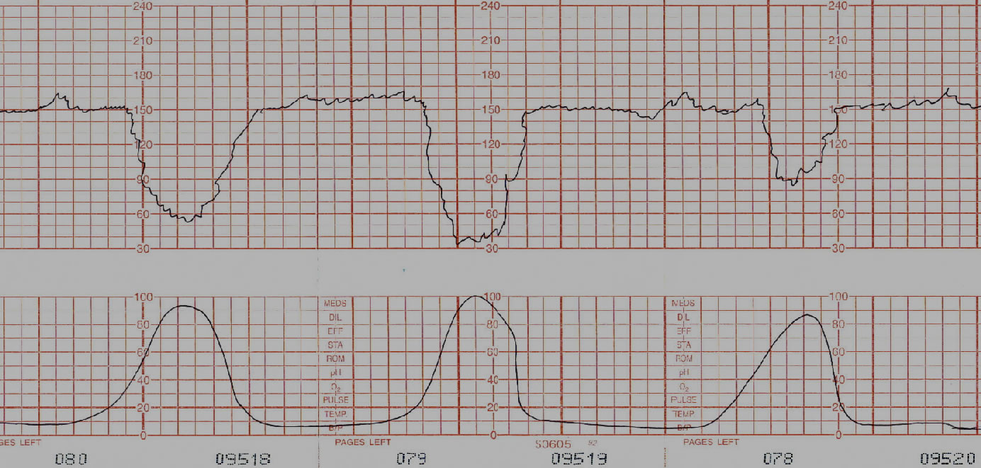
Variable Decelerations

Slide 50
Variable Decelerations
Periodic: Occurring with a contraction
Episodic: Independent of uterine contractions

Slide 51
Prolonged Decelerations
A prolonged deceleration is present when there is a visually apparent decrease in FHR from the baseline that is greater than or equal to 15 bpm, lasting greater than or equal to 2 minutes, but less than 10 minutes.
A deceleration that lasts 10 minutes is a baseline change.

Slide 52
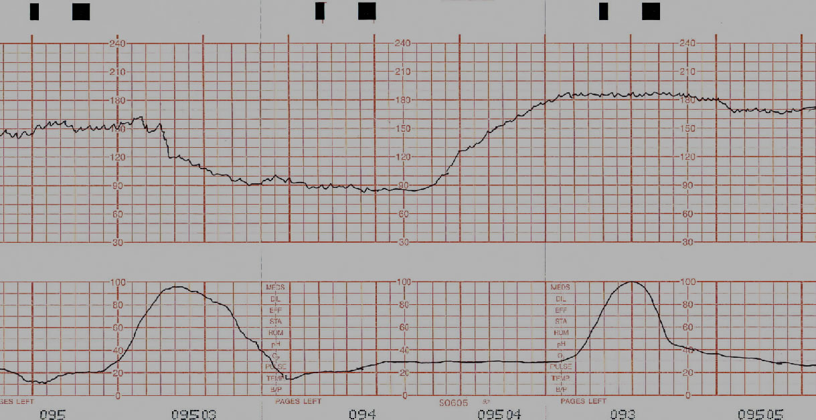
Prolonged Deceleration

Slide 53
Prolonged Deceleration

Slide 54
Decelerations
Recurrent: Occur with greater than or equal to 50% of UCs in a 20-minute period
Intermittent: Occurring with less than 50% of UCs in a 20-minute period
Notes:
The terminology REPETITIVE has been eliminated but it is still utilized frequently.

Slide 55
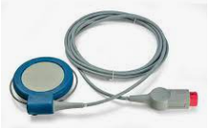
Methods of Monitoring FHR
External:
Ultrasound: Detects fetal movement
Benefits:
Non-invasive
Provides permanent record
Records baseline, variability, and patterns
Limitations:
Maternal movement restricted
Tracing quality affected by position, maternal size, etc.

Slide 56
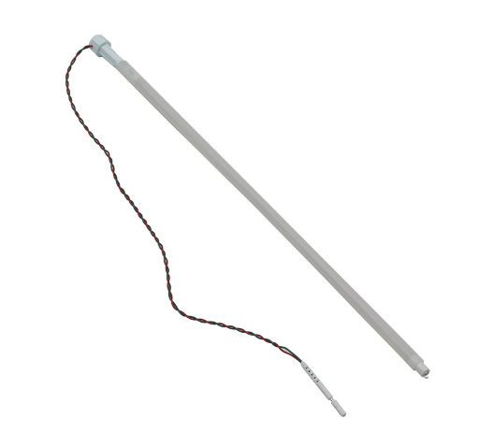
Internal Monitoring
Fetal spiral electrode (FSE): Direct monitoring of fetal ECG
Benefits:
Provides continuous FH tracing
Maternal position and body
habitus does not affect tracing quality
Limitations/risk:
Invasive
Requires ruptured membranes/cervical dilation
Risk of infection
Improper placement
Notes:
Discuss discontinuation of Phillips FSE due to injury claims. FSE can be placed on cervix and record maternal HR. Story of demise with maternal tachycardia. FSE should only be used if unable to trace with external device.

Slide 57
Uterine Activity
Uterine contractions are quantified as the
number of contractions present in a
10-minute window, averaged over 30 minutes.
Contraction frequency alone is a partial assessment of uterine activity. Other factors such as duration, intensity, and relaxation time between contractions are equally important in clinical practice.

Slide 58
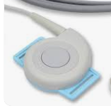
Methods of monitoring Uterine Contractions
External:
Palpation: fingertips detect firmness
Subjective
Uterine toco: Detects changes in shape of abdomen
Accurate only for frequency and duration of contraction

Slide 59
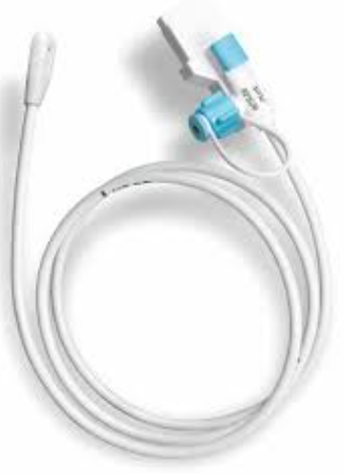
Intrauterine Pressure Catheter (IUPC)
Quantitative measurement of strength of uterine contractions and resting tone
Provides accurate assessment of intensity (strength), duration, frequency, and resting tone.
Port for amnioinfusion
Limitations/risks:
Invasive, requires ROM
Can increase infection risk
Placement

Slide 60
MVU’s (Montevideo units)
MVU’s are an index of uterine activity based on pressure changes (measured in mm HG) in the uterus during contractions
They are measured with an intrauterine pressure catheter (IUPC)
They are calculated by subtracting the baseline IUPC pressure from the peak contraction pressure of each contraction in a 10-minute window and adding the results together

Slide 61
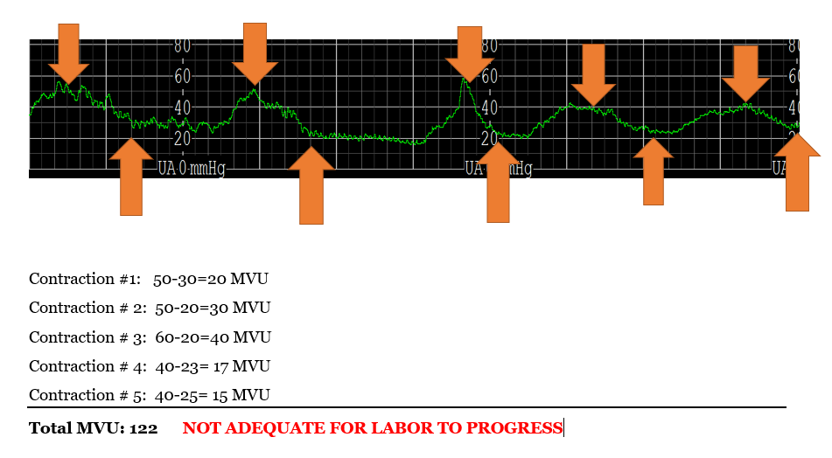
MVU’s (Montevideo units)
200 MVU within 10 minutes is considered adequate
Notes:
Many nurses do not know how to calculate MVU’s and utilize the software in their fetal monitoring system: it auto-generates the number. Important for nurses to understand how it is obtained.
This tracing may demonstrate tachysystole, but it is utilized merely for education purposes

Slide 62
MVU’s (Montevideo units)

Slide 63
Uterine activity
Normal
Tachysystole
greater than 5 contractions in 10 minutes averaged over a 30-minute window.
5 contractions or less in 10 minutes, averaged over a 30-minute window.

Slide 64
Tachysystole
Tachysystole should always be qualified as to the presence or absence of associated FHR decelerations.
The term tachysystole applies to both spontaneous or stimulated labor. The clinical response to tachysystole may differ depending on whether contractions are spontaneous or stimulated.
The terms hyperstimulation and hypercontractility are not defined and should be abandoned.
Notes:
Stimulated: miso/cervidil/foley balloon, Pitocin

Slide 65
Treatment for Tachysystole
Be aware of your unit policy
Reposition patient
Fluid bolus
Decreasing or discontinuing Oxytocin
Administration of Terbutaline
Notify provider if necessary
Notes:
Perform interventions to decrease contraction frequency and to maximize oxygenation and placental perfusion.
Nurses have own independent license and must follow hospital policy even if providers says differently. Talk about provider saying “leave pit on; she needs to be delivered”

Slide 66
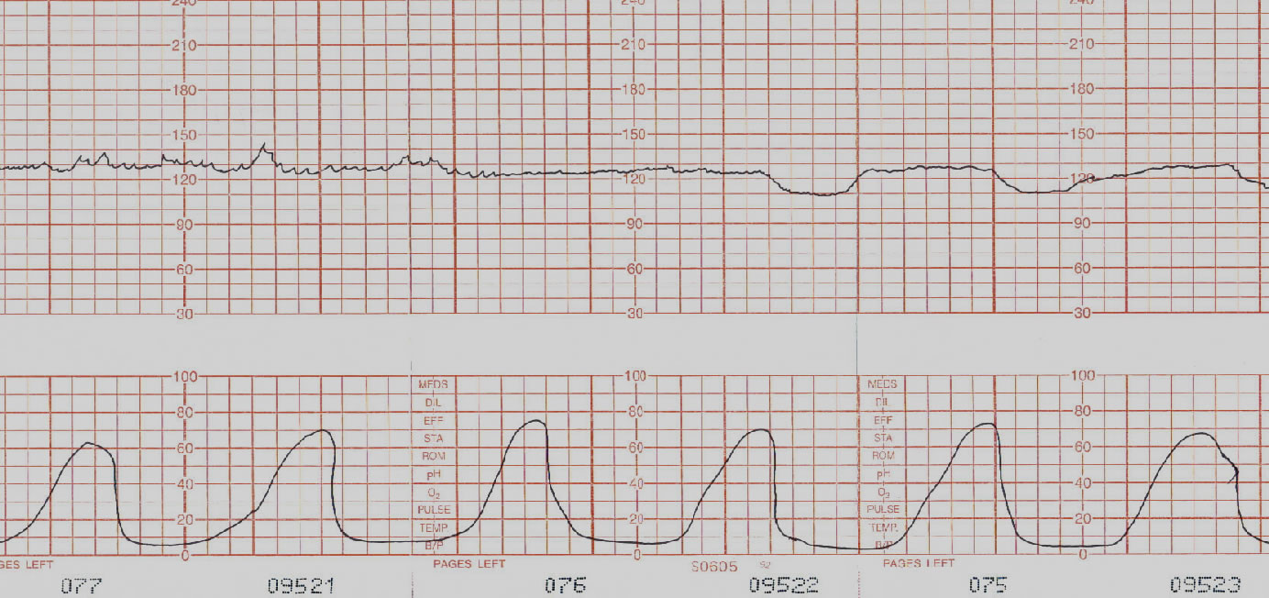
Tachysystole
Notes:
Look at this tracing carefully: This patient has 6 contractions in 9 minutes. Look on the left side where there is moderate variability. Many fetuses cannot maintain moderate variability with too frequent contractions. There is insufficient time to re-perfuse the intervillous space in the placenta and eventually the fetus can no longer compensate.

Slide 67
Tachysystole
Notes:
Inadequate relaxation in between contractions. Need minimum of 60 seconds between

Slide 68
Intrinsic influences on FHR:
Factors within the fetus:
Fetal circulation
Autonomic nervous system response
Baroreceptors
Chemoreceptors
Hormonal responses
Notes:
Baroreceptors: Protective stretch receptors located in carotid arteries in fetus: Effect fetal blood pressure: involved in variable decelerations
Chemoreceptors: regulate respiratory activity and control circulation by responding to change in acid-base balance; acts to slow fetal heart rate and involved in decelerations

Slide 69
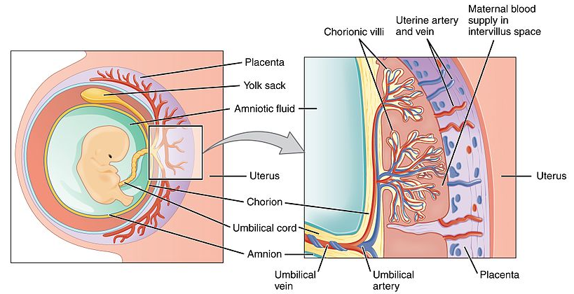
Extrinsic influences on FHR
Factors outside of the fetus: Maternal-fetal circulation:
Placenta
Maternal utero-placental circulation
Fetal-placental circulation
Placental transfer
Uterine blood flow
Umbilical cord
Amniotic fluid

Slide 70
Placental Circulation
Notes:
Point out intervillous space: Maternal blood reaches the intervillous space of the placenta via uteroplacental spiral arteries.
Maternal blood pressure propels the blood, bathing the fetal chorionic villi allowing for exchange of gases.
Fetal oxygenation depends on well-oxygenated maternal blood flow to placenta.
Discuss epidural/transient hypotension, asthma, CHF, severe anemia

Slide 71
Interpretation
The FHR tracing should be interpreted in the
context of the overall clinical circumstances, and
categorization of a FHR tracing is limited to the
time period being assessed.
The presence of FHR accelerations (either spontaneous or stimulated) reliably predicts the absence of fetal acidemia at that moment
The absence of accelerations does not, however, reliably predict fetal acidemia
Notes:
Accelerations can be obtained via scalp stimulation or vibro-acoustic stimulation, but never during a deceleration: only in the baseline

Slide 72
Interpretation continued…
Moderate FHR variability reliably predicts the absence of fetal metabolic acidemia at the time it is observed.
Minimal or absent FHR variability alone
does not reliably predict the presence of fetal
hypoxemia or metabolic acidemia.
The significance of marked FHR variability is unclear.
Notes:
Remember: It is only a screening tool

Slide 73
Three Tier Categories
Category 1 tracings: Normal
Category 2 tracings: Indeterminate
Category 3 tracings: Abnormal
Notes:
2008 NICHD guidelines suggest a 3 tiered system for interpretation of FHR patterns

Slide 74
Three Tier Categories
Given that the fetal heart rate response is a dynamic process, and one that evolves over time, the categories of FHR patterns are dynamic and transient, requiring frequent reassessment.
It is common for FHR tracings to move from one category to another over time.
The FHR tracing should be interpreted in the context of the overall clinical circumstances, and categorization of a FHR tracing is limited to the
time period being assessed.

Slide 75
Category I
Category I fetal heart rate (FHR) tracings are considered NORMAL and include all the following:
Baseline rate: 110-160 beats per minute
Baseline FHR variability: moderate
Late or variable decelerations: absent
Early decelerations: present or absent
Accelerations: present or absent

Slide 76
Category 1 Tracing
Notes:
Moderate variability with accelerations and no decelerations

Slide 77
Category 1 Tracing
Notes:
Moderate variability with no accelerations

Slide 78
Category 1 Tracing
Notes:
Moderate variability with early decelerations

Slide 79
Category II
Category II tracings are indeterminate.
They require evaluation, continued surveillance, and interventions guided by the clinical picture
Notes:
Represent majority of tracings

Slide 80
Category II
Category II FHR tracings include all FHR tracings not categorized as Category I or Category III.
Category II tracings may represent an appreciable fraction of those encountered in clinical care.
Most tracings in the 2nd stage are Category II.

Slide 81
Examples of Category II FHR tracings include any of the following:
Baseline rate
Tachycardia with minimal variability
Baseline FHR variability
Minimal baseline variability
Absent baseline variability not accompanied by recurrent decelerations
Marked baseline variability

Slide 82
Examples of Category II FHR tracings include any of the following:
Decelerations:
Recurrent variable decelerations accompanied by minimal or moderate baseline variability
Recurrent late decelerations with moderate or minimal baseline variability
Prolonged deceleration lasting 2 minutes but less than 10 minutes

Slide 83
Category 2 Tracing
Notes:
Moderate variability with recurrent variables

Slide 84
Category 2 Tracing
Notes:
Minimal variability: someone might say there are accelerations, but they do not meet 15X15 criteria. Look at the majority of the tracing for determination

Slide 85
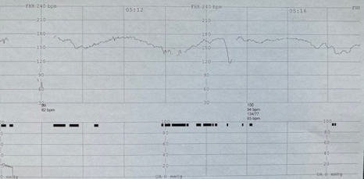
Category 2 Tracing
Notes:
Tachycardia with minimal variability and recurrent decelerations

Slide 86
Category 2 Tracing
Notes:
prolonged

Slide 87
Category 2 Tracing
Notes:
Minimal variability with recurrent decelerations:
You can see that some Category 2 tracings are much more concerning than others. On the left you can see that there are 2 minutes of baseline, but no baseline anywhere else. If the two minute baseline was not present, you would say the baseline is indeterminate.

Slide 88
Category III
Are predictive of abnormal fetal acid-base status at the time of the observation
Requires prompt evaluation and expedited birth

Slide 89
Category III
Category III FHR tracings include either:
Absent baseline FHR variability plus any of the following:
Recurrent late decelerations
Recurrent variable decelerations
OR…
Bradycardia
Sinusoidal pattern

Slide 90
Category 3 Tracing
Notes:
Tachycardia is not a category 3 tracing by itself. If there is tachycardia with absent variability and recurrent lates as this tracing does, it is a category 3

Slide 91
Category 3 Tracing
Notes:
Absent variability with recurrent lates

Slide 92
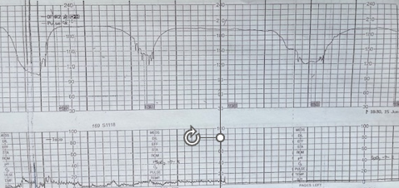
Category 3 Tracing
Notes:
Absent variability with recurrent decelerations

Slide 93
Category 3 Tracing
Notes:
sinusoidal

Slide 94
Category 3 Tracing
Notes:
Bradycardia: if it did not resolve: note that pulse oximeter is on patient, so that you can be certain that you are monitoring the baby

Slide 95
Fetal Oxygenation
Dependent upon:
Maternal Circulation
Uterine Circulation
Placental Circulation
Umbilical circulation
Fetus

Slide 96
Systematic decision making
Includes a solid interpretation of the tracing using your systematic assessment
Baseline, Variability, Periodic and episodic changes, uterine activity, pattern evolution, accompanying clinical characteristics, urgency.
Includes:
Intrapartum goals
Ongoing assessment
Physiologic interventions
Clinical evaluation
Notes:
It is much more important to intervene with a concerning tracing, rather than to define it. Arguments about recurrent variables vs. recurrent lates are not important. They both require immediate intervention to fix the interruption in the oxygen pathway.

Slide 97
Environment
1
All clinically significant FHR decelerations (late, variable, prolonged) reflect interruption of the pathway of oxygen transfer from the environment to the fetus
Sustained or recurrent interruption of oxygen transfer eventually can lead to injury
Lungs
Heart
Vasculature
Uterus
Placenta
Oxygen transfer
Cord
Fetus
Hypoxemia
Hypoxia
Metabolic acidosis
Fetal response
Metabolic acidemia
Potential Injury
Notes:
Interruption in the pathway can occur anywhere: Asthma, cardiac issues, low blood pressure, tachysystole, calcified placenta, short cord:

Slide 99
Environment
Intrapartum FHR Interpretation
Three Central Concepts
Lungs
Heart
Vasculature
Variable, late or prolonged decelerations signal interruption of oxygen transfer
Uterus
Placenta
Cord
Fetus
Moderate variability or accelerations reliably predict the absence of metabolic acidemia
Hypoxemia
Hypoxia
Metabolic acidosis
Metabolic acidemia
Potential injury
Injury requires significant metabolic acidemia
Notes:
Lungs: asthma
Heart: cardiac disease, CHF

Slide 100
Interruption in the oxygen pathway
Notes:
Prolonged, minimal variability, recurrent lates: Need corrective measures:

Slide 101
Interruption in the oxygen pathway
Notes:
Fix quality of tracing, reduce number of contractions to allow re-perfusion, less pushing, USE of PULSE OX!, request bedside consultation, expedite birth, have neonatal team available

Slide 102
2nd stage management: should this patient be pushing with every contraction?
Notes:
Question for thinking? Note 5 pushes per contraction: most decelerations appear late: push with every other, fluid bolus, reposition, expedite birth: decelerations meet criteria for significant:

Slide 103
Fetal Response to Decreased Oxygen
Redistribution of blood to vital organs:
Brain, heart, and adrenal glands
Alterations in behavioral state:
Decreased fetal movement
Decreased variability
Aerobic to anaerobic metabolism
Fetal response is affected by blood flow to uterus and placenta, integrity of the placenta, and blood flow through the umbilical cord
Notes:
Fetus with adequate oxygen reserve can be sustained despite fetal oxygen delivery: fetal metabolic functions will continue aerobically even through fetal hypoxemia.
Fetus with depleted reserves: fetal hypoxemia will be associated with tissue hypoxia, resulting in anaerobic metabolism and potentially tissue death.

Slide 104
Interventions to Decrease Maternal Oxygen Consumption
Promote maternal relaxation
Coach with helpful breathing
Manage pain
Maintain acceptable uterine activity in some cases decreasing activity
Use antipyretics to reduce fever
Reposition the mother
Provide appropriate management of the second stage of labor.

Slide 105
Definitions of key terms
Base Deficit: HCO3 (bicarbonate) concentration lower than normal
Base Excess: HCO3 concentration higher than normal
Acidemia: Increased concentration of hydrogen ions in the blood
Acidosis: Increased concentration of hydrogen ions in the tissue

Slide 106
Definitions of key terms
Hypoxemia: decreased oxygen content in the blood
Hypoxia: Decreased level of Oxygen in the tissue
Asphyxia: Hypoxia, acidemia, and metabolic acidosis

Slide 107
Standardized FHR Interpretation Consensus:
Intrapartum interruption of fetal oxygenation does not result in neurologic injury (cerebral palsy) unless it progresses to the stage of significant metabolic acidemia (umbilical artery pH < 7.0 and base deficit ≥ 12 mmol/L)

Slide 108
Acid-Base Analysis
 | Target Values | Metabolic Acidemia | Respiratory Acidemia
PH | >7.20 | <7.20 | <7.20
pO2 | >20 | <20 | Variable
pC02 | <60 | <60 | >60
BD (base deficit) | <12 | >12 | <12
BD (base excess) | >-12 | <-12 | >-12
Notes:
This is not scary: know 3 numbers:
If PH is above 7.2: STOP: you have a normoxic fetus
If it is below; there is some type of acidemia:
Metabolic, respiratory, or mixed

Slide 109
Respiratory acidemia:
increased C02 levels
Can develop rapidly
Can be corrected rapidly, usually with first breath at birth
Notes:
Inability to clear CO2, accumulation of free hydrogen ions in blood that cause drop in PH

Slide 110
Metabolic Acidosis:
lactic acid levels
Results from anaerobic metabolism
Takes longer to develop
Takes longer to resolve
Notes:
If decrease in blood flow is significant or problem with sufficient oxygen getting to placental intervillous space, peripheral tissues shift to anaerobic metabolism.
Anaerobic metabolism results in production of lactic acid. When lactic acid exceeds buffering capacity, this results in metabolic acidemia, which, if uncorrected extends to vital organs

Slide 111
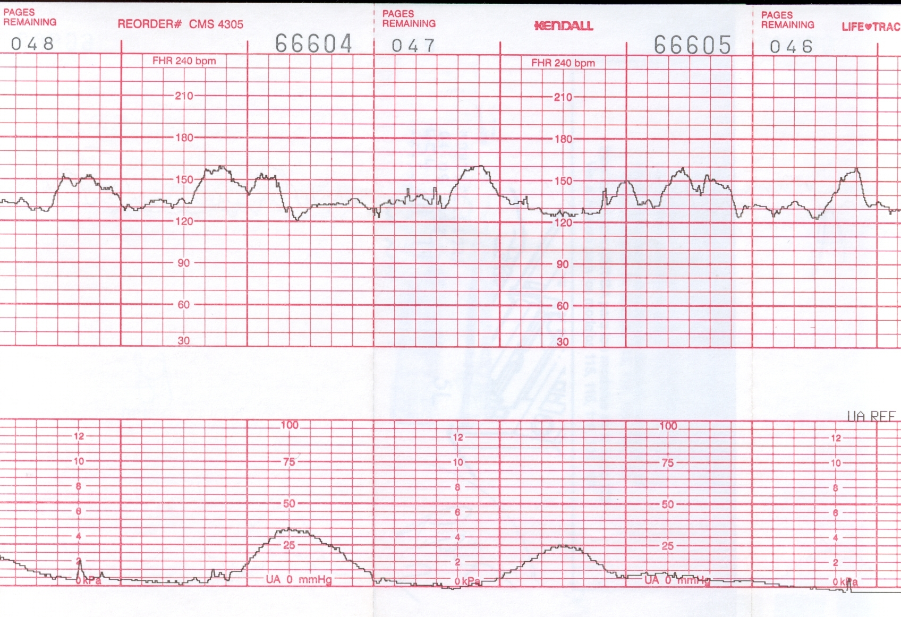
Moderate FHR variability reliably predicts the absence of metabolic acidemia at the time it is observed

Slide 112
FHR accelerations reliably predict the absence of fetal metabolic acidemia at the time they are observed

Slide 113
Category 2 tracing algorithm:
Notes:
Clarke algorithm: decision making algorithm:
Originally thought that it would increase cesarean rates, but actually lowered them: allowed for continuation of concerning tracings

Slide 114
References:
AWHONN Fetal Heart Monitoring: Principles and Practices
Up to Date

